Slide 1

SRI VENKATESWARA COLLEGE OF ENGINEERING, TIRUPATI
HACK-VOUCHER
DEPARTMENT OF COMPUTER SCIENCE AND ENGINEERING
Under the guidance of : Presented By :
Dr. K SANTHI, Ph.D Dulla Pravalika - 19BF1A0545
Associate Professor Gunda Sudarrshan - 19BF1A0554
Putturu Nivas - 19BF1A0569
Chakram Joycy Ikya - 19BF1A0527

Slide 2
CONTENTS
ABSTRACT
PROBLEM STATEMENT
SYSTEM REQUIREMENTS
EXISTING SYSTEM
DRAWBACKS
PROPOSED SYSTEM
ADVANTAGES
UML DIAGRAMS

Slide 3
ABSTRACT
As a result of the pandemic, our country has undergone a wave of digital transformation over the past two years. As a result of lack of choice, concerns about safety, or just convenience, consumers have been taking to digital means to fulfill their needs. This change in behavior boosted the growth of the e-commerce industry in India. Due to an increase in internet and smartphone penetration, that segment had already experienced rapid growth, but the pandemic tripled it. Payments for everything, from groceries to clothes to books to personal care products, are now made online. This has led to the growth of e-commerce companies like Flipkart, Amazon, and Myntra, Zomato etc., that offer vouchers/gifts cards to promotes the online transactions and payments.

Slide 4
Problem statement
It is an online market place where user sell and buy the voucher that they get from different e-commerce website like google pay, amazon pay, BHIM , UPI etc. and are of no use for a particular user but useful for other. So basically, In this Project which we are building, voucher hosting platform where user can sell vouchers there and can purchase useful vouchers like discount coupons, cashback coupons etc in exchange of a point that is to be added in their wallet.

Slide 5
SYSTEM REQUIREMENTS
H/W CONFIGURATION :
Processor - I3/Intel Processor
Hard Disk - 160GB
Key Board - Standard Windows Keyboard
Mouse - Two or Three Button Mouse
Monitor - SVGA
Ram - 8Gb

Slide 6
S/W CONFIGURATION
Operating System : Windows 7/8/10
IDE : VSCode
Libraries Used : Bootstrap, NPM Modules
Technologies : NodeJs , ExpressJs , Mongo DB

Slide 7
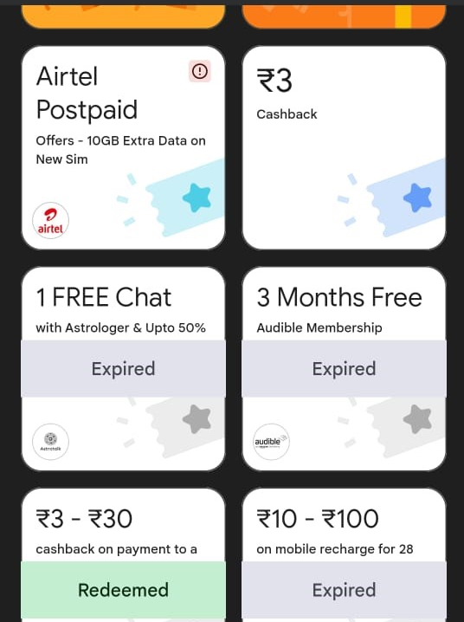
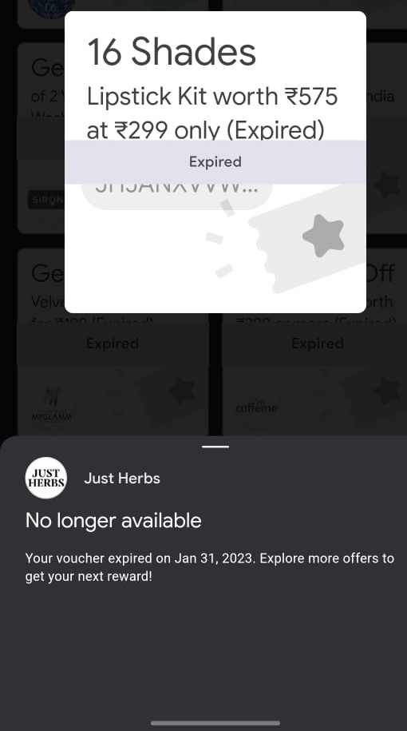
EXISTING SYSTEM

Slide 8
DRAWBACKS
Wastage of coupons.
Individual sharing.
No alters Regarding the coupons Deadline.

Slide 9
proposed system
We can also develop android apps and launch on play store. Android app make more interactive UI and easy to use for users
We can also implement filter such a way that user view voucher of their interest and also get a notification on their profile and email when someone added a voucher of their interest.
We will include automate verification of vouchers.
User Profile Building (Based on Contribution).

Slide 10
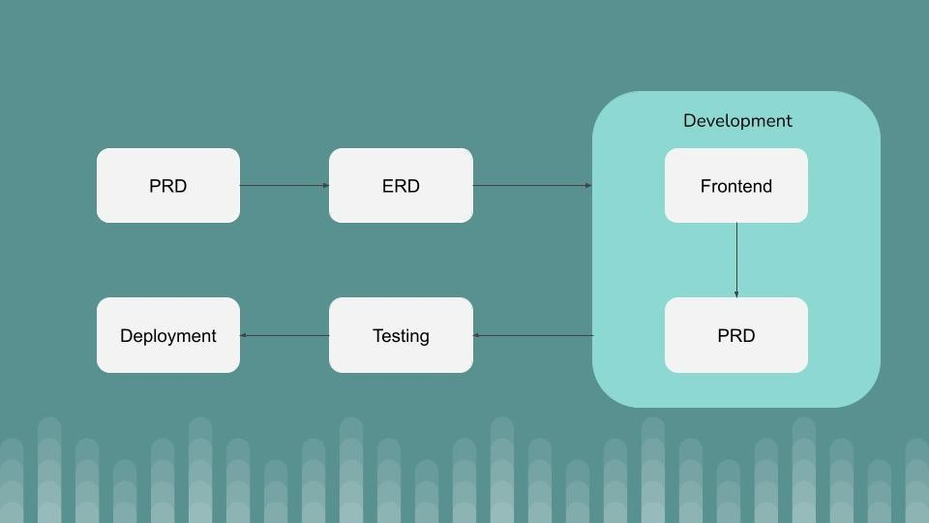
Different stages of the software cycle action plan

Slide 11
ADVANTAGES
Easier availability of coupons.
Best Advantage for sender.
Multiple sharing.

Slide 12
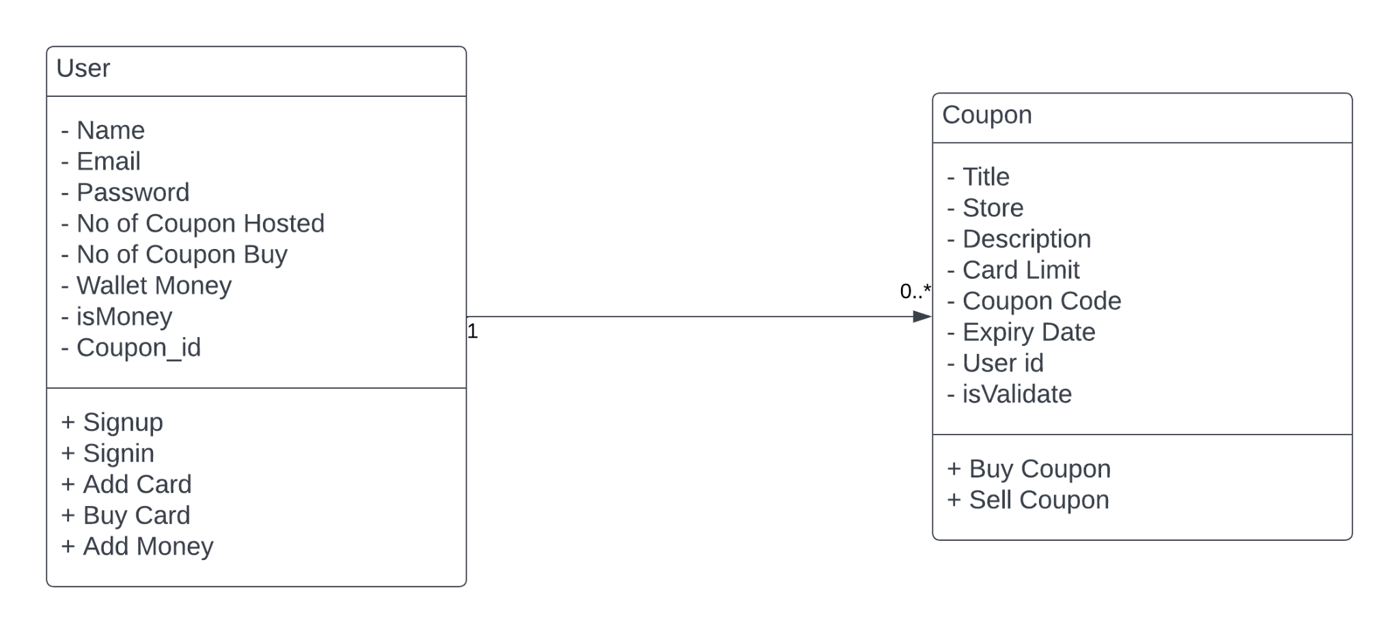
UML DIAGRAMS CLASS DIAGRAM

Slide 13
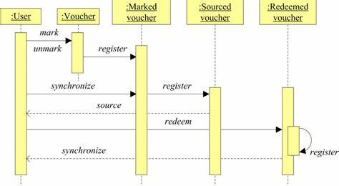
SEQUENCE DIAGRAM

Slide 14
COMPONENT DIAGRAM

Slide 15
REFRENCES
https://www.geeksforgeeks.org/
https://www.researchgate.net/publication/283699248_Gift_cards_a_review_and_research_agenda
https://www.persistencemarketresearch.com/market-research/gift-card-market.asp
https://stackoverflow.com/
https://www.tutorialspoint.com/index.htm
https://w3schools.com/

Slide 16
THANK YOU

